Slide 1

Prime Night Club Locations in Bellevue

Slide 2

Why
Seattle has major Party spots in the Northwest
Bellevue which has similar mix of money and young folks has less prominent night life.
Opening up Night Club will improve Bellevue’s reputation as party town helping a lot of industries and lifestyle of folks around along with improving the tourism.

Slide 3
How
We will compare Bellevue Neighborhoods with Seattle night club neighborhoods and see how they stack up against one another
Bellevue Neighborhoods resembling Seattle Neighborhoods (having large number of Nigh clubs) could be prime areas for setting up shop

Slide 4
Data Acquisition
I primarily used data from Four Square to get all venues in Seattle and Bellevue.
I used Geopy library to map locations to neighborhoods since it comes integrated with multiple APIs I didn’t have to bother about accessing different API’s. It was a 1 stop shop.
Even with above advantage of Geopy I was cautious with the data, since it varied in specific scenarios and was such scenarios were not used.

Slide 5
Data Cleaning
Four Square Night life data for Bellevue and Seattle had multiple categories of venues which were aligned to make sure we were comparing similar categories
Neighborhood column from Geopy and Foursquare was unreliable, alternatively Suburb was used for Seattle and Hamlet for Bellevue. Even though they are named differently, these field represent neighborhoods.

Slide 6
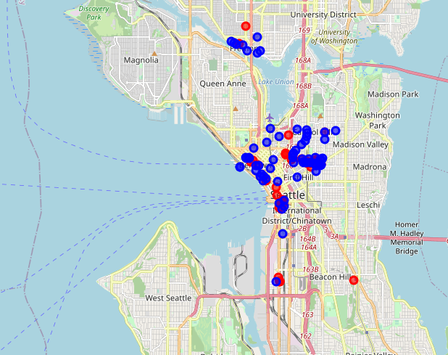
Plotting Seattle Night life vs Night Clubs

Slide 7
Correlation
Given the high density of Night life venues around the Night Clubs in Seattle, proves our initial hypothesis that the 2 correlate
Now we can cluster the Seattle and Belleve neighborhoods to find prime Neighborhoods to setup shop

Slide 8
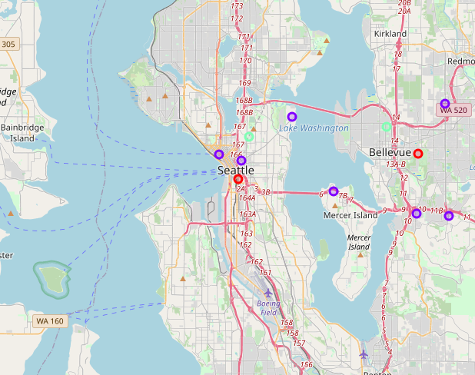
Plotting Seattle and Bellevue Neighborhoods clusters

Slide 9
Result & Conclusion
We see that Neighborhoods between Seattle and Bellevue fall in different clusters.
Neighborhoods in Red (cluster- 0 ), International District/ Chinatown in Seattle and Belridge in Bellevue. We note International District has around 13 Night clubs where as Belridge none, even though the two correlate highly
Hence we find the starting Night Clubs in Belridge, Bellevue might be a great idea.

